Slide 1
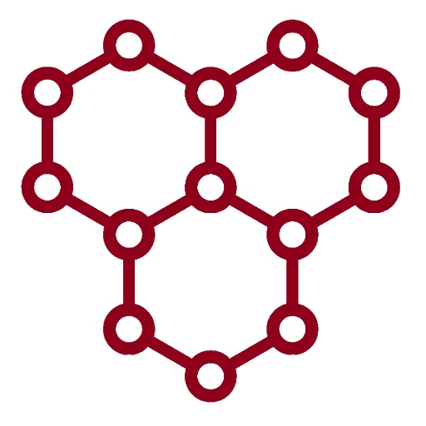
Graphene Sensing Application Quick-start
By: Lukas Scarfe

Slide 2
Notes
This guide is not the full documentation. For full documentation please see the word document.
This PowerPoint will go over how to use the basic functions of uOttawa's Graphene Sensing application.
After going through this presentation you will be able to
Configure the software.
Take + save: resistance, temperature, ethanol, humidity measurements over a given period of time.
Control the devices connected to the setup.
Configure and run back-gate measurements during experiments.
Run pre-configured, automated experiments.
Debug basic errors.

Slide 3
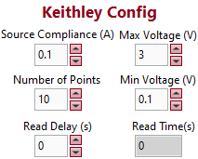
Configuring the software 1: Keithley 2400
The Keithley 2400 is used to take resistance measurements. This device sweeps between 2 voltages, measuring current.
Upon opening the program, this is how the settings are initialized ------>
This means that the Keithley will sweep between 0.1 and 3 V with 10 intermediate points.
With these settings the Keithley takes about 0.25s to take measurements
If you would like for the Keithley to take longer between measurements, it is suggested to increase the Read Delay setting. This adds a delay between measurements
In most situations, the default settings are acceptable
Source compliance is the maximum current the Keithley will let flow through the sensor.

Slide 4
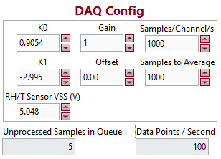
Configuring the software 2: DAQ 6343
The DAQ 6343 is used for measuring Ethanol, RH, and Temperature. It is also used to control the LED, and the valves.
Upon opening the program, this is how the settings are initialized ------>
K9, K1, Gain, Offset, and RH/T Sensor VSS are settings for calibration of the sensors.
Samples/Channel/s and Samples to average are the settings used to control the speed of data acquisition.
Samples/Channel/s ÷ Samples to Average is the number of Data Points/Second.
In most situations, the default settings are acceptable, and will take 1 measurement per second.

Slide 5
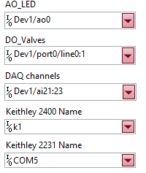
Configuring the software 3: Channels
The software only knows which device it is talking to through the use of channels.
This section is where you choose which device is on what channel and port.
The default configuration should be correct however, if you are not sure what device is on what channel, use NI MAX.

Slide 6
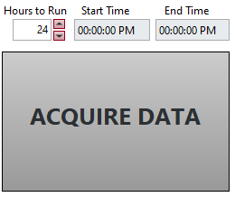

Taking Measurements
Taking measurements is very simple, all that you have to do is input the length of time for the sensing to take place, and press “Acquire Data”.
This will begin plotting the data, and start a timer countdown to stop when the End Time is reached.
If you would like to save the data, press the Save to File slider BEFORE pressing the “Acquire Data” button. It is suggested to input a file name, but is not required. The resulting files will be saved in the TestData folder.
Multiple files will be saved, one containing the IV curves, and one containing all of the DAQ data (as well as the average resistance) w.r.t time.

Slide 7
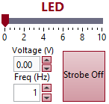
Controlling Connected Devices 1: LED
The LED is controlled by either moving the slider or typing in the desired voltage.
There is a strobe option, and a control to indicate the desired frequency of strobing.
These controls work as long as the software is open, you are not required to be running a test.

Slide 8
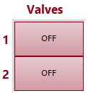
Controlling Connected Devices 1: Valves
There are 2 valves connected to the system.
They can be turned on or off.
These controls work as long as the software is open, you are not required to be running a test.

Slide 9
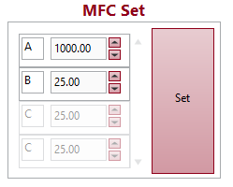
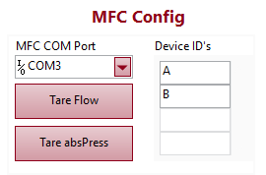
Controlling Connected Devices 1: MFCs
The mass flow controllers are controlled by naming them (convention is to use alphabet), and then inputting a number for their mass flow.
Once the desired inputs have been inputted, pressing “Set” will change the MFCs to output the desired mass flow.
If you would like to add a mass flow controller, you must add it in both MFC Config and MFC Set.
These controls work as long as the software is open, you are not required to be running a test.

Slide 10
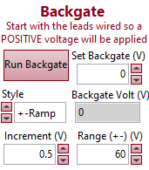
Configure and Run Backgate Measurements
To set a backgate voltage, all that must be done is to input value in “Set Backgate” control.
To run a backgate sweep, you must decide on a maximum voltage as well as an increment, then press “Run Backgate”.
When prompted to switch the polarity of the leads, do so. Once finished, please press the “OK” Button.
If you would like more information on “Style”, hover your mouse over the command in the software.

Slide 11
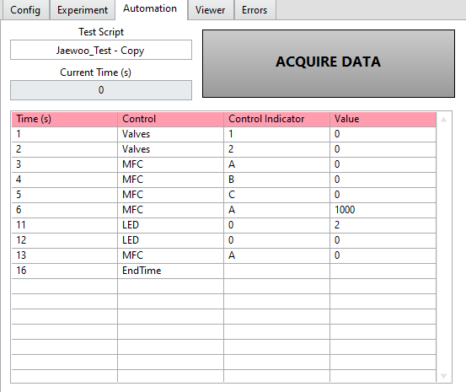
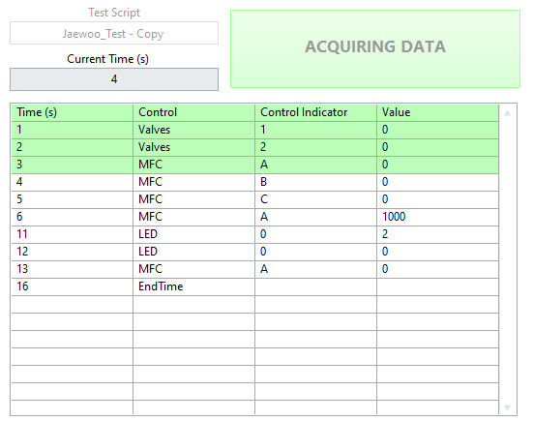


Run Pre-Configured, Automated Experiments
To run an automated test, go to the Automation Tab.
Select Test Script from the dropdown menu, and finally press Acquire Data.
The list will highlight commands green once they are completed.
If “None” is selected for “Test Script”, then the software will run as configured with the timeout.
If you would like information on how to create Scripts, please see the Scripting word document.

Slide 12
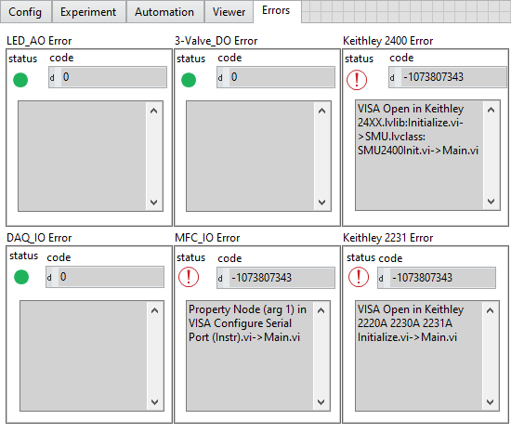
Debugging Basic Errors.
All errors will be displayed in the “Errors” tab.
Most errors are due to either equipment not being properly connected, or incorrectly selected channels.
Step 1: Check that all devices are connected correctly, and powered appropriately.
Step 2: Check the “Config” tab and assure that all devices are properly configured.
Step 3: If neither steps 1 or 2 worked, restart the software, and if that does not work then restart the computer. Sometimes computers just need a good old fashioned turn off and on again ☺.

Slide 13
End
Congratulations, you can now use all of the basic functions of uOttawa’s Graphene sensing application.
A review of what you learned:
Configure the software.
Take + save: resistance, temperature, ethanol, humidity measurements over a given period of time.
Control the devices connected to the setup.
Configure and run back-gate measurements during experiments.
Run pre-configured, automated experiments.
Debug basic errors.

